Slide 1
Traffic Signal Controller
Harshal Chowdhary 2K19/EC/071

Slide 2
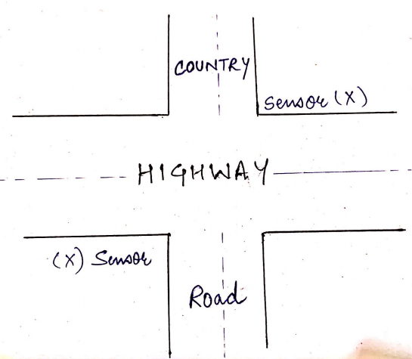
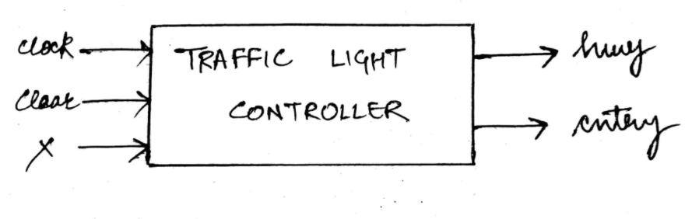
Specifications of Model

Slide 3
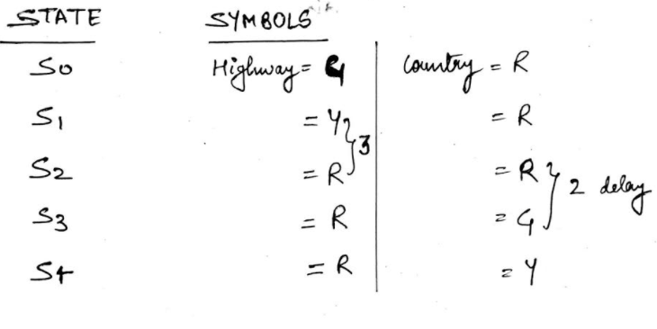
State Definition

Slide 4
X = 0
S0
X = 1
Y2R
S4
S1
X = 0
Y2R
S3
S2
R2G
STATE DIAGRAM
X = 1

Slide 5
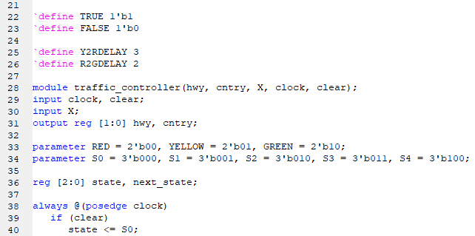
Verilog Code

Slide 6
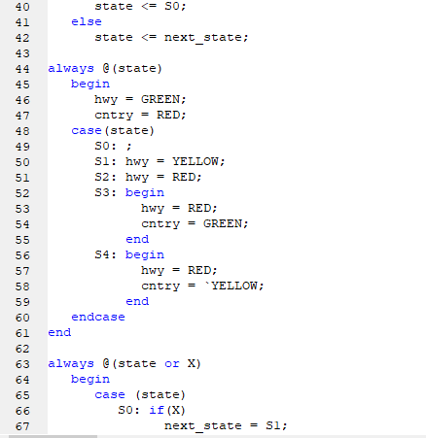
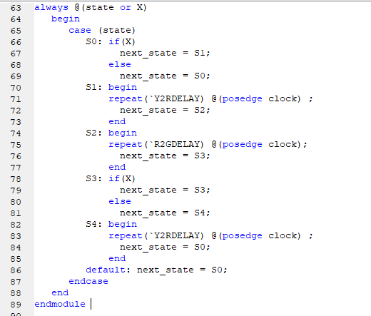
Verilog Code

Slide 7
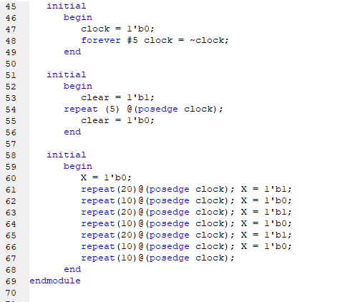
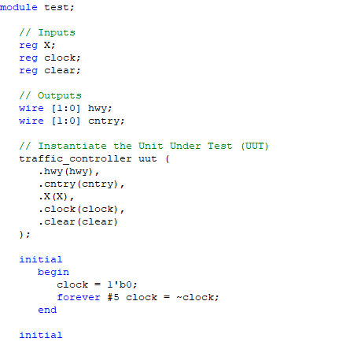
Verilog Test Module

Slide 8
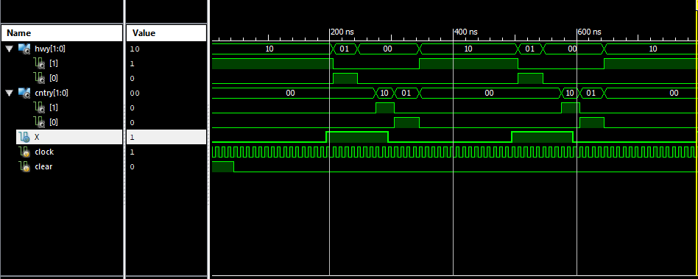
Simulation Result

